Slide 1
SharePoint 2007 Implementing Publishing Sites
© 2008 Alexander Pajer

Slide 2
Agenda
Web Content Management Overview
Implementing Page Layouts
Deployment in a Publishing Environment
Customizing Editing Experience
Implementing Multi Language Scenarios
Implementing Field Types and Controls

Slide 3
Web Content Management Overview

Slide 4
Web Content Management Features
Adds the following functionality to SharePoint
Variations, Translation Library and Workflow
Resusable Content, Page Editing and Smart Client Authoring
Additional Security Elements
Content Deployment
Content and Structure Report List

Slide 5
Variations
Variations are language or device spcific implementations of sites
SharePoint supports automatic redirection using the Language-Country ID – LCID
Language Packs for supported Languages should be installed

Slide 6
Reusable Content
The Reusable Content Library is there to store text fragments that you might want to re-use in your Publishing Environment
By implementing reusable content you can guarantee consistency within a site collection

Slide 7
Smart Client Authoring
Smart Client Authoring is the process of automatic conversion from proprietary format to web page.
Smart Client Authoring is supported for
Microsoft Office Word
Microsoft Office InfoPath
Conversion occurs between Documents and Pages Libraries by Document Conversion Services

Slide 8
Additional Security Elements
Permission Levels
Approve
Design
SharePoint Groups
Approvers
Designers
Hierarchy Managers
Manage Hierarchy
Restricted Read
Quick Deploy Users
Restricted Readers

Slide 9
Content Deployment
SharePoint supports two methods of content deployment from a staging environment to live environment
Scheduled Content Deployment
Quick-Deployment

Slide 10
Content and Structure Report List
Several Reports will provide information about your Publishing Sites, such as:
Checked Out to me
Last Modified by me
Pending Approval
My Tasks
All Draft Documents
Going Live within next seven days
Expiring within next seven days

Slide 11
Demo
Implementing Publishing Sites
Implementing Smart Client Authoring using Document Conversion

Slide 12
Implementing Page Layouts

Slide 13
Page Layout Model
Page Layouts use Content Types to determine the type of data that can be displayed.
Site Column
Start Date
ExpirationDate
Contact
...
Content Type
Page
Page Layout
Associate
Custom Content

Slide 14
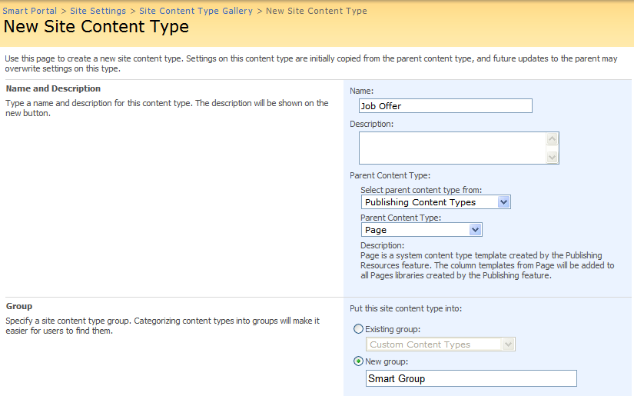
Publishing Content Types
Content Types used to implement Page Layouts for Publishing typically inherit from Page

Slide 15
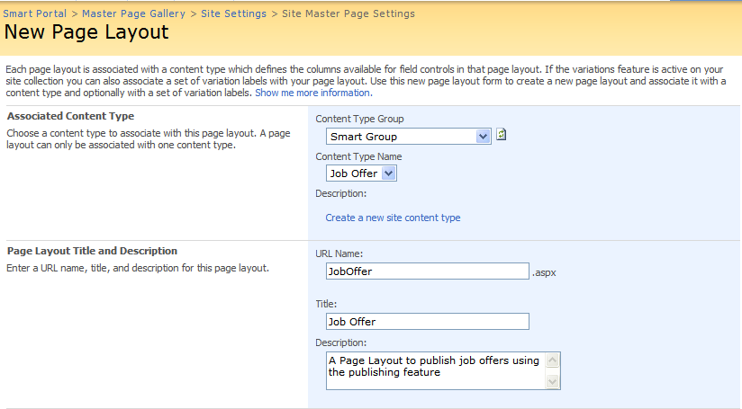
Content Type Association
Content Type Association is done using the „New Page Layout“ command

Slide 16
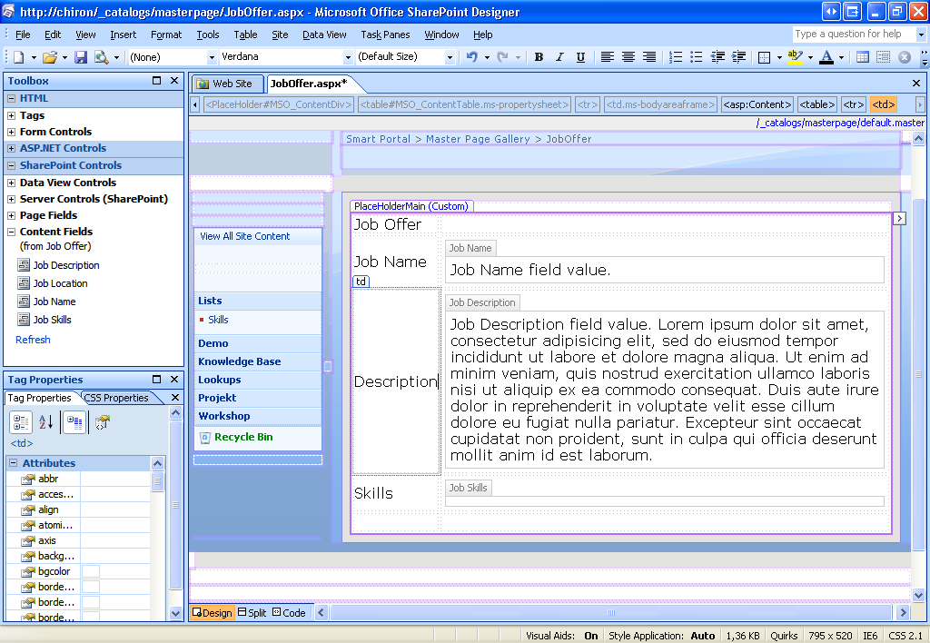
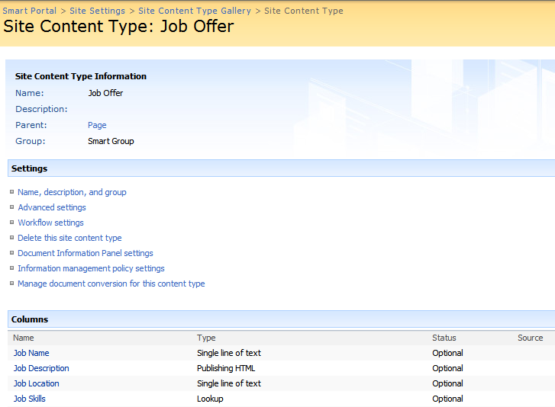
Designing Page Layouts
Page Layouts can be designed using SPD

Slide 17
Demo
Implementing a custom Page Layout

Slide 18
Deployment in a Publishing Environment

Slide 19
Content Caching
SharePoint supports two methods of caching
Page output caching
Disk caching

Slide 20
Page Output Caching
Page Output Caching is implemented by Cache Profiles
After a page request is serviced from the database, SharePoint stores the resultion objects in memory
Subsequent requests are serviced from memory until the cache is purged

Slide 21
Disk Caching
SharePoint stores static files like pictures, JavaScript on disk to avoid roundtrips to the database
Disk Caching is enabled in web.config
<BlobCache location=“D:\BlobCache" path="\.(gif|jpg|png|css|js)$" maxSize="10" enabled="false" />

Slide 22
Content Deployment
SharePoint supports deployment to empty site collections
// Create an empty site collection
STSADM.EXE -o createsite -url <url> -ownerlogin domain\user -owneremail <email-address>
Staging Site
Live Site
Deployment Path

Slide 23
Scheduled Content Deployment
Steps to implement Scheduled Deployment
Create Production Site Collection
Allow Incoming Content Deployment Jobs
Create Content Deployment Path from Staging to Live
Create Content Deployment Job

Slide 24
Content Deployment Path, -Job
Deployment Paths connect Source and Target Site Collections
Deployment of Security Principals is optional
A Content Deployment Job moves content from the staging site to the live site using a Content Deployment Path

Slide 25
Quick Deployment
Quick Deployment allows Deployment of individual content by a seperate schedule using the Page Editing Toolbar
Users must be member of Quick Deploy user group

Slide 26
Demo
Implementing Caching
Implementing Content Deployment

Slide 27
Customizing Editing Experience

Slide 28
Customize HTML Editor Field Control
Options in the HTML Editor can be customized in the individual Page Layout
<PublishingWebControls:RichHtmlField id="ArticleAbstract" FieldName="ArticleAbstract"
AllowExternalUrls="false"
AllowFonts="true"
AllowReusableContent="false"
AllowHeadings="false"
AllowHyperlinks="false"
AllowImages="false"
AllowLists="false"
AllowTables="false"
AllowTextMarkup="false"
AllowHTMLSourceEditing="false"
DisalbeBasicFormattingButtons="false" runat="server"/>

Slide 29
Adding Buttons to HTML Editor
Custom Buttons and Commands can be added to the HTML Editor by modifying RTE2ToolbarExtension.xml in the EditingMenu Folder of the Masterpage Gallery
<?xml version="1.0" encoding="utf-8" ?>
<RTE2ToolbarExtensions>
<RTE2ToolbarExtraButton id="extraButtonTestId"
src="RTE2ToolbarExtraButtonTest.js" />

Slide 30
Custom Button JavaScript
Custom JS for extending the Menu must implement
OnClickCallback
OnResetStateCallback
Mnemonic (ID) for the button
IconURL
Text
ToolTip

Slide 31
Demo
Customize the Page Edit Toolbar

Slide 32
Implementing Multi Language Scenarios

Slide 33
Language Template Packs
Allow creation of sites in multiple Languages on the same WSS instalation
Language Packs have to be installed on all Front-End Servers
Ordinary Sites are not automatically displayed according to the Browser Language Tag. This can be archieved using Variation Hierarchies

Slide 34
Translation Library
Helps managing translation for documents in multilingual environments by keeping a relationship between source documents and translations
Uses a Translators list in order to maintain information about who is responsible for which language translation

Slide 35
Translation Workflow
Manages translations from source documents into the destination language.
Tanslation languages can be designated as requird language

Slide 36
Variation Home
All Variations must share a common root within the site collection
Default.aspx is changed to variationroot.aspx in order to implement redirection logic
The home site should not be used for content

Slide 37
Variation Hierarchy
Variations are language or device specific implementations of a source site
Variation Lables are instances of a certain Variation
One Variation Lable has to be designated as the source variation

Slide 38
Demo
Installing SharePoint Language Packs
Implementing a Variation Hierachie
Using Translation Workflow and Library

Slide 39
THANK YOU!!
ALEXANDER.PAJER@INTEGRATIONS.AT

